Slide 1
C++ Programming(Exercise) 8
Arne Kutzner
Hanyang University / Seoul Korea

Slide 2
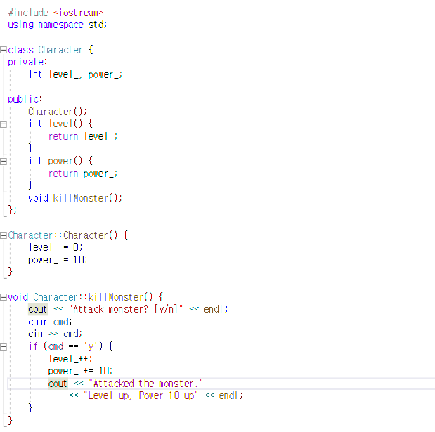
Example

Slide 3
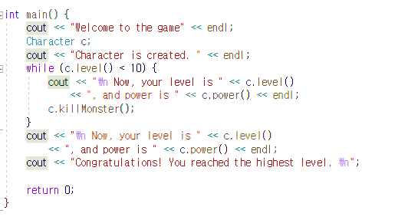
Example(Continue)

Slide 4
this-pointer
this returns a reference to the current object.
- ex) Circle::Circle(double radius){
this -> radius = radius;
(radius of current object) (constructor’s argument)
}
this points ites

Slide 5
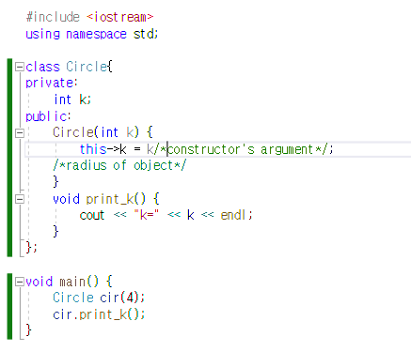
this-pointer(example)

Slide 6
Inheritance
You can create a new class that inherits from an existing class.
The new class is a specialization of the existing class( = subclass).
You can add new members/methods, and can also replace methods

Slide 7
Inheritance(Continued)
Example: You have a class which represents ‘circles’.
Create a new class that represents the ‘cylinders’.
There are some similarities between 2 classes(radius, for example)
You can inherit radius for ‘cylinders’ from ‘circles’ class.

Slide 8
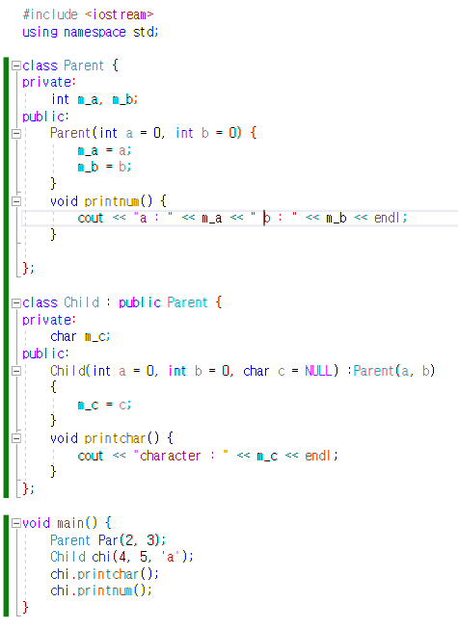
Inheritance(Example)

Slide 9
Friends
Class can declare other classes as ‘friend classes’
Class can declare external functions as ‘friends’
Friends can access private members / methods

Slide 10
Friend Declaration
class a {
private:
int i, j;
***
friend class b;
friend int printa( a &f1) ;
}

Slide 11
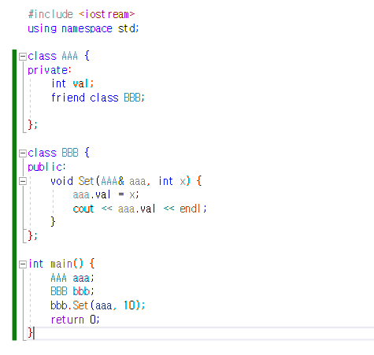
Friend(Example)

Slide 12
Overloading vs Overriding
Overloading: Allows creating several methods with same name which differ from each other in the type of input/output of the function. (Polymorphism)
Overriding: Allows a child class to provide a specific implementation of a method that is already provided by one of its parent classes.
class C
{
public :
void test(int a);
void test(char b);
}
class D : public C
{
public :
void test(int a);
int test(int a);
}

Slide 13
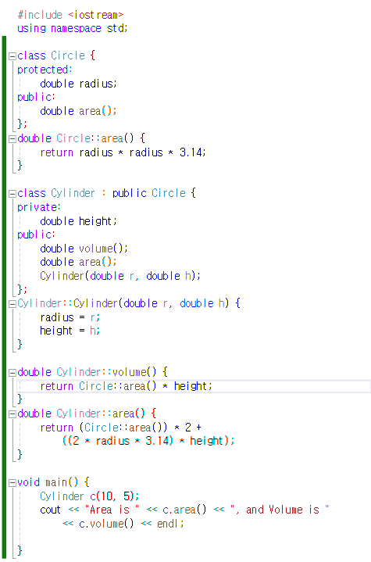
Method overriding

Slide 14
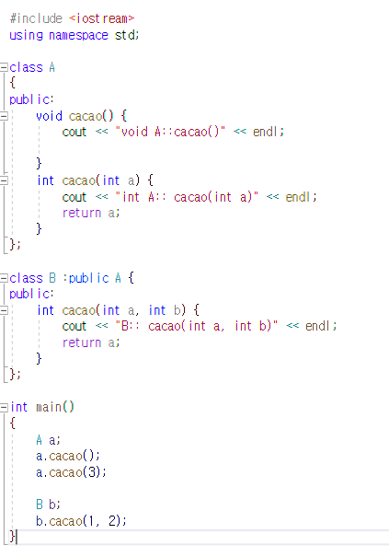
Overriding & Overloading

